Slide 1
Today’s Class
6:00PM – 7:30PM: Working in a Reproducible Environment:
R Projects, R Markdown, R Notebooks
Creating and editing R Markdown files
7:45PM – 9:00PM: Importing Data with Base R and the Tidyverse
9:00PM – 9:50PM: Coding Exercises (importing data to begin your midterm project)

Slide 2
first date guidelines…
for data
Visualize
Get
Clean
Transform
Communicate
Model
Understand
Program
☨A modified version of Hadley Wickham’s analytic process

Slide 3
“What we have is a data glut.”
- Vernon Vinge

Slide 4
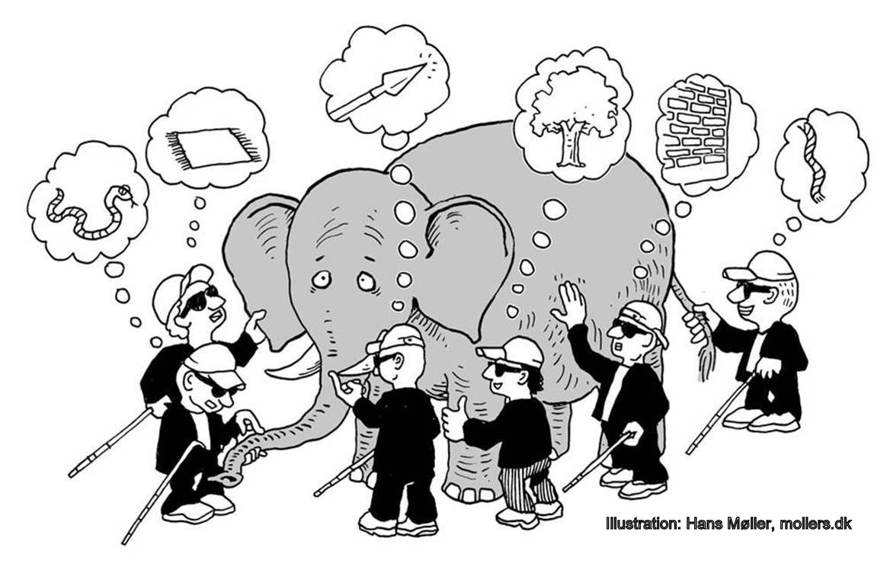
“Unless the data is something I’ve analyzed a lot before, I usually feel like the blind men and the elephant.”
- Jeff Leek

Slide 5
first things to do
Don’t try to kiss your data on the first date; rather, you just want to get to know the data:
?
?
?
?

Slide 6
first things to do
Don’t try to kiss your data on the first date; rather, you just want to get to know the data:
Import the data
Review the codebook
Learn about the data
Quick visual understanding of the data

Slide 7

data import

Slide 8
flat files
What are the main functions to read in a .csv file?
Function | Package
? | ?
? | ?
? | ?

Slide 9
flat files
What are the main functions to read in a .csv file?
Function | Package
read.csv | utils (Base R)
read_csv | readr
fread | data.table

Slide 10


flat files
How are these functions the same?
read.csv(“mydata.csv”)
read_csv(“mydata.csv”)
fread(“mydata.csv”)
csv
data frame

Slide 11
flat files
How do these functions differ?

Slide 12
flat files
How do these functions differ?
1. Base R vs. Packages
# Base R
read.csv(“data/flights.csv”)
# Load package readr
library(readr)
readr::read_csv(“data/flights.csv”)
# Load package data.table
library(data.table)
fread(“data/flights.csv”)

Slide 13
flat files
How do these functions differ?
1. Base R vs. Packages
2. Speed
# Slowest
read.csv(“data/flights.csv”)
# Faster
library(readr)
readr::read_csv(“data/flights.csv”)
# Fastest
library(data.table)
fread(“data/flights.csv”)
~4 seconds
~0.8 seconds
~0.3 seconds

Slide 14
flat files
How do these functions differ?
1. Base R vs. Packages
2. Speed
3. Variable attributes
# read.csv defaults to saving character variables as factors
df <- read.csv(“data/flights.csv”)
str(df)
'data.frame': 336776 obs. of 19 variables:
$ year : int 2013 2013 2013 2013 2013 2013 2013 2013 2013 2013 ...
$ month : int 1 1 1 1 1 1 1 1 1 1 ...
$ day : int 1 1 1 1 1 1 1 1 1 1 ...
$ dep_time : int 517 533 542 544 554 554 555 557 557 558 ...
$ sched_dep_time: int 515 529 540 545 600 558 600 600 600 600 ...
$ dep_delay : num 2 4 2 -1 -6 -4 -5 -3 -3 -2 ...
$ arr_time : int 830 850 923 1004 812 740 913 709 838 753 ...
$ sched_arr_time: int 819 830 850 1022 837 728 854 723 846 745 ...
$ arr_delay : num 11 20 33 -18 -25 12 19 -14 -8 8 ...
$ carrier : Factor w/ 16 levels "9E","AA","AS",..: 12 12 2 4 5 12 4 6 4
$ flight : int 1545 1714 1141 725 461 1696 507 5708 79 301 ...
$ tailnum : Factor w/ 4043 levels "D942DN","N0EGMQ",..: 180 524 2401
$ origin : Factor w/ 3 levels "EWR","JFK","LGA": 1 3 2 2 3 1 1 3 2 3 ...

Slide 15
flat files
How do these functions differ?
1. Base R vs. Packages
2. Speed
3. Variable attributes
# read.csv defaults to saving character variables as factors
df <- read.csv(“data/flights.csv”, stringsAsFactors = FALSE)
str(df)
'data.frame': 336776 obs. of 19 variables:
$ year : int 2013 2013 2013 2013 2013 2013 2013 2013 2013 2013 ...
$ month : int 1 1 1 1 1 1 1 1 1 1 ...
$ day : int 1 1 1 1 1 1 1 1 1 1 ...
$ dep_time : int 517 533 542 544 554 554 555 557 557 558 ...
$ sched_dep_time: int 515 529 540 545 600 558 600 600 600 600 ...
$ dep_delay : num 2 4 2 -1 -6 -4 -5 -3 -3 -2 ...
$ arr_time : int 830 850 923 1004 812 740 913 709 838 753 ...
$ sched_arr_time: int 819 830 850 1022 837 728 854 723 846 745 ...
$ arr_delay : num 11 20 33 -18 -25 12 19 -14 -8 8 ...
$ carrier : chr "UA" "UA" "AA" "B6" ...
$ flight : int 1545 1714 1141 725 461 1696 507 5708 79 301 ...
$ tailnum : chr "N14228" "N24211" "N619AA" "N804JB" ...
$ origin : chr "EWR" "LGA" "JFK" "JFK" ...

Slide 16
flat files
How do these functions differ?
1. Base R vs. Packages
2. Speed
3. Variable attributes
# read.csv defaults to saving character variables as factors
df <- read.csv(“data/flights.csv”, stringsAsFactors = FALSE)
str(df)
'data.frame': 336776 obs. of 19 variables:
$ year : int 2013 2013 2013 2013 2013 2013 2013 2013 2013 2013 ...
$ month : int 1 1 1 1 1 1 1 1 1 1 ...
$ day : int 1 1 1 1 1 1 1 1 1 1 ...
$ dep_time : int 517 533 542 544 554 554 555 557 557 558 ...
$ sched_dep_time: int 515 529 540 545 600 558 600 600 600 600 ...
$ dep_delay : num 2 4 2 -1 -6 -4 -5 -3 -3 -2 ...
$ arr_time : int 830 850 923 1004 812 740 913 709 838 753 ...
$ sched_arr_time: int 819 830 850 1022 837 728 854 723 846 745 ...
$ arr_delay : num 11 20 33 -18 -25 12 19 -14 -8 8 ...
$ carrier : chr "UA" "UA" "AA" "B6" ...
$ flight : int 1545 1714 1141 725 461 1696 507 5708 79 301 ...
$ tailnum : chr "N14228" "N24211" "N619AA" "N804JB" ...
$ origin : chr "EWR" "LGA" "JFK" "JFK" ...
Both read_csv & fread default
to stringsAsFactors = FALSE

Slide 17
what about other flat files?
Package | Function | .CSV | .TSV | .TXT | FIXED WIDTH | SPECIAL SEPARATOR
utils (Base R) | read.csv | x
 | read.delim |  | x
 | read.table |  |  | x |  | x
readr | read_csv | x
 | read_tsv |  | x
 | read_table |  |  | x | x
 | read_fwf |  |  |  | x
 | read_delim |  |  |  |  | x
data.table | fread | x | x | x | x | x

Slide 18
what about excel files?

Slide 19
to read in excel files
readxl
Function | Description
? | preview sheet names in specified Excel file
? | reads in excel file
? | write to UTF-8 encoded .csv

Slide 20
to read in excel files
readxl
Function | Description
excel_sheets | preview sheet names in specified Excel file
read_excel | reads in excel file
readr::write_excel_csv | write to UTF-8 encoded .csv
Other packages allow you to write directly to, and format, Excel files. You can learn these on your own time.

Slide 21
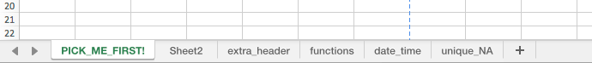
reading in a file
Excel is still the spreadsheet software of choice
You need to understand both the workbook and the sheet that you want to read in
# identify the sheet you want
excel_sheets(“data/mydata.xlsx")
[1] "PICK_ME_FIRST!" "Sheet2" "extra_header" "functions"
[5] "date_time" “unique_NA”

Slide 22
reading in a file
Excel is still the spreadsheet software of choice
You need to understand both the workbook and the sheet that you want to read in
# identify the sheet you want
excel_sheets(“data/mydata.xlsx")
[1] "PICK_ME_FIRST!" "Sheet2" "extra_header" "functions"
[5] "date_time" “unique_NA"
# now read in the data
read_excel("data/mydata.xlsx", sheet = "PICK_ME_FIRST!")
# A tibble: 3 × 3
`variable 1` `variable 2` `variable 3`
<dbl> <chr> <dbl>
1 10 beer 1
2 25 wine 1
3 8 cheese 0

Slide 23
OTHER OPTIONS
GDATA
XLConnect
ROBC
RExcel
All require Java or Perl dependencies

Slide 24

Codebook

Slide 25
the codebook
A codebook is a technical description of the data that was collected for a particular purpose
Should be the first thing you review before any kind of analysis
Understanding the source data is crucial to any analysis.

Slide 26
what
Original source of the data
How the data are generated
Variable definitions
Missing data encodings

Slide 27
why
Organizational data often represent multiple truths
Organizations are increasingly integrating internal and external data sources
Analysts need to understand what assumptions or nuances are represented by the data
Understand what you are analyzing!

Slide 28
important
This aligns with project standards: 3.1 & 3.2

Slide 29

learn about your data

Slide 30
learn about the data
So what are the first things we want to know about our data?
?
?
?
?

Slide 31
learn about the data
So what are the first things we want to know about our data?
dimensions
data types (i.e. character, integer, factor, etc.)
missing values
summary statistics
What are some functions to extract this information?

Slide 32
learn about the data
So what are the first things we want to know about our data?
dimensions: dim(), ncol(), nrow(), names()
data types: str(), class(), is., as.
missing values: is.na(), sum(is.na()), colSums(is.na())
summary statistics: summary(), quantile(), var(), sd(), table()

Slide 33
reporting
Reporting this information in your data dictionary/preparation section is important:
How many missing values did you remove or impute
The range and most likely values for each variable
Example values seen in each variable
It’s good practice to show at least the first few lines of your data so the reader can get a feel for the data: (i.e. View(), head())

Slide 34
important
This aligns with project standards: 3.3-3.5

Slide 35

get to know visually

Slide 36
learn about the data
For quick data exploration, base R plotting functions can provide an expeditious and straightforward approach to understanding your data
What are some functions to extract this information?

Slide 37
quick plots
Function | Description
? | scatter plot
? | line chart
? | bar chart
? | histogram
? | box plot
? | stem & leaf plot

Slide 38
quick plots
Function | Description
plot(x, y) | scatter plot
plot(x, y, type = “l”) | line chart
barplot(table(x)) | bar chart
hist(x) | histogram
boxplot(y ~ x, data) | box plot
stem(x) | stem & leaf plot

Slide 39
important
This somewhat aligns to standard 4.2; however, in week 5 you will learn to create much more meaningful visualizations.

Slide 40

time to flex our new knowledge muscles!
Let’s review and apply what you’ve learned a use-case

Slide 41
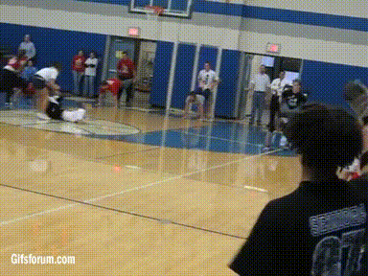
Group challenge

Slide 42

excel files
xxxx.xlsx

Slide 43
import
What spreadsheets are contained in the aircraft.xlsx file?
Read in the Trainers worksheet data without the header information.

Slide 44
solution
# 1. What spreadsheets are contained in the aircraft.xlsx file?
library(readxl)
excel_sheets("data/aircraft.xlsx")
[1] "Bombers" "Fighters" "Trainers"
[4] "UAV_Drones" "Tankers_Transporters"

Slide 45
solution
# 2. Read in the Trainers worksheet data without the header information.
aircraft <- read_excel("data/aircraft.xlsx", sheet = "Trainers", skip = 3)
aircraft
# A tibble: 187 x 6
Type MD FY FH Gallons Cost
<chr> <chr> <dbl> <dbl> <dbl> <dbl>
1 Trainer AT-38 1996 12517 6681614 5641569
2 Trainer AT-38 1997 11656 7707001 6506680
3 Trainer AT-38 1998 12619 9749881 9526089
4 Trainer AT-38 1999 13132 10534024 9343636
5 Trainer AT-38 2000 14400 10769237 7242603
6 Trainer AT-38 2001 12674 9680191 10533477
7 Trainer AT-38 2002 1143 4107850 4813961
8 Trainer AT-38 2003 -1561 2793119 2953701
9 Trainer AT-38 2004 -1972 2579471 2995067
10 Trainer AT-38 2005 -1713 2727529 4996524
# ... with 177 more rows

Slide 46
numeric understanding
Look at the summary information for this data. Anything seem odd?
Which aircraft MDs are represented?
Are there any missing years between 1996-2014 in this data?
90% of flying hours fall under what value?
What is the spread of the range of costs?

Slide 47
solution
# 3. Look at the summary information for this data. Anything seem odd??
summary(aircraft)
Type MD FY FH
Length:187 Length:187 Min. :1996 Min. :-62827
Class :character Class :character 1st Qu.:2001 1st Qu.: 679
Mode :character Mode :character Median :2006 Median : 1788
Mean :2006 Mean : 26929
3rd Qu.:2011 3rd Qu.: 33090
Max. :2014 Max. :147928
Gallons Cost
Min. : -373147 Min. : 567
1st Qu.: 11450 1st Qu.: 106344
Median : 352201 Median : 1616098
Mean : 8646004 Mean : 15554466
3rd Qu.:10526094 3rd Qu.: 11166048
Max. :62154004 Max. :158058171

Slide 48
solution
# 4. Which aircraft MDs are represented?
table(aircraft$MD)
AT-38 T-1 T-38 T-41 T-51 T-53 T-6 TC-130 TC-135 TH-1 TU-2
19 19 19 19 15 4 15 13 19 7 19
UV-18
19

Slide 49
solution
# 5. Are there any missing years between 1996-2014 in this data?
unique(aircraft$FY)
[1] 1996 1997 1998 1999 2000 2001 2002 2003 2004 2005 2006 2007 2008 2009 2010
[16] 2011 2012 2013 2014
table(aircraft$FY)
1996 1997 1998 1999 2000 2001 2002 2003 2004 2005 2006 2007 2008 2009 2010 2011
7 7 8 8 9 9 10 9 9 10 10 10 11 11 11 12
2012 2013 2014
12 12 12

Slide 50
solution
# 6. 90% of flying hours fall under what value?
quantile(aircraft$FH, prob = .9)
90%
109828.8

Slide 51
solution
# 7. What is the spread of the range of costs?
# range
range(aircraft$Cost)
[1] 567 158058171
# spread
max(aircraft$Cost) - min(aircraft$Cost)
[1] 158057604
# or…
diff(range(aircraft$Cost))
[1] 158057604

Slide 52
visual understanding
How would you describe the distribution of flying hours?
If we wanted to focus on only the trainers with the largest variance in flying hours, which MDs would we select?
Are all FYs equally represented?

Slide 53
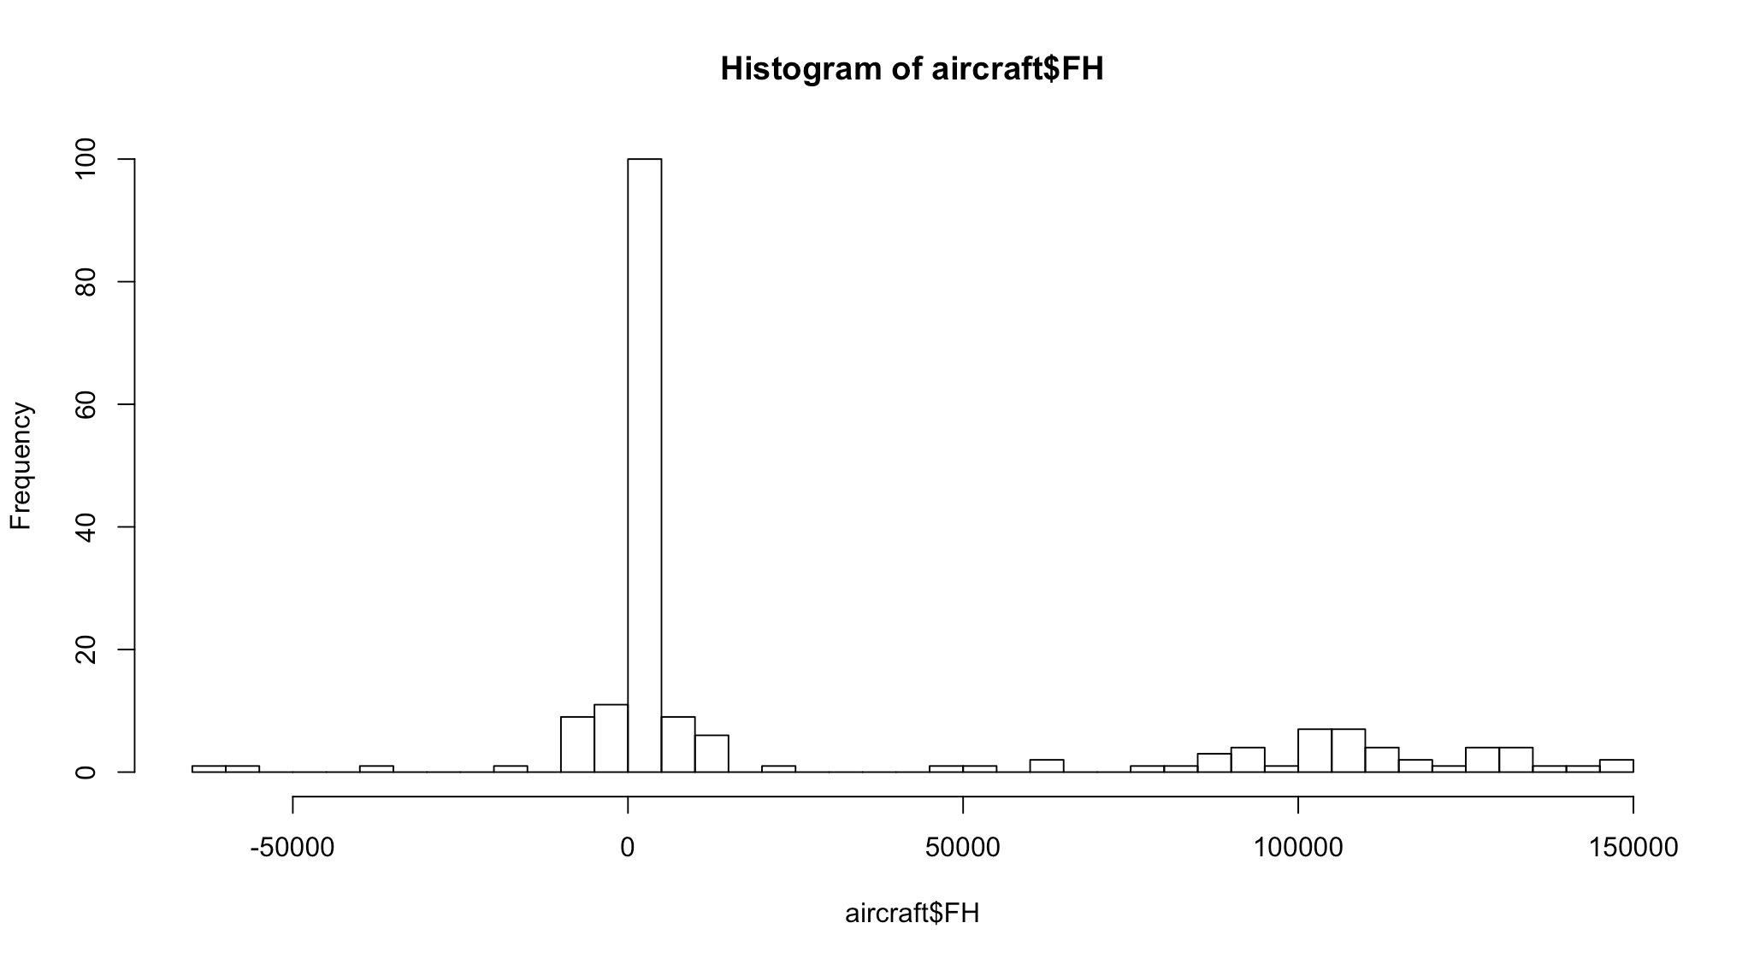
solution
# 8. How would you describe the distribution of flying hours?
hist(aircraft$FH, breaks = 50)

Slide 54
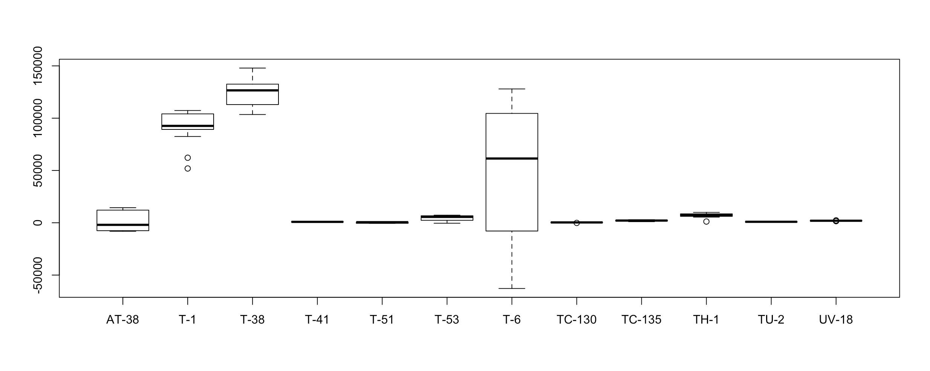
solution
# 9. If we wanted to focus on only the trainers with the largest variance in
# flying hours, which MDs would we select?
boxplot(FH ~ MD, data = aircraft)

Slide 55
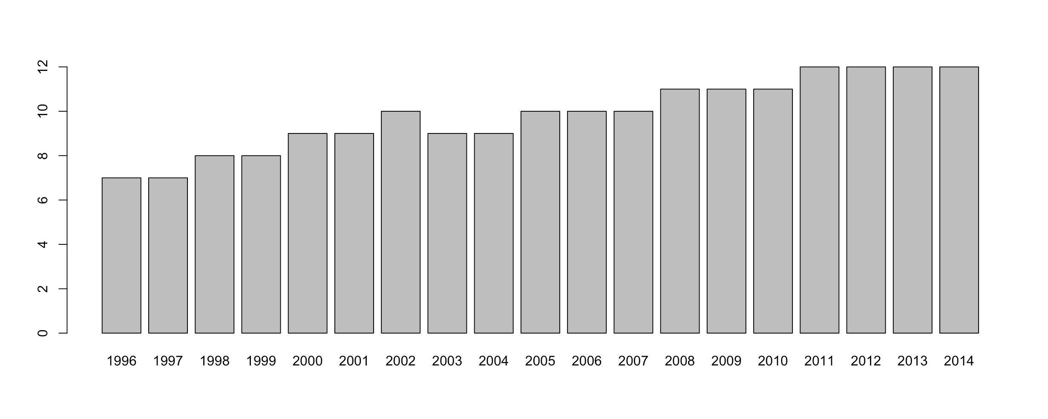
solution
# 10. Are all FYs equally represented?
barplot(table(aircraft$FY))

Slide 56

online file
www.something.com

Slide 57
Tasks
Scrape the Cincinnati weather data: http://academic.udayton.edu/kissock/http/Weather/gsod95-current/OHCINCIN.txt
What is the average temperature for Cincinnati?
What has been the hottest and coldest temperature? Does this seem odd?
Recode the missing values (-99) to NA. Now what is the max, min, and mean temperature?
Look at the distribution of temperatures by month. What kind of pattern do you see?

Slide 58
solution
# 1. Scrape the Cincinnati weather data:
# http://academic.udayton.edu/kissock/http/Weather/gsod95-current/OHCINCIN.txt
library(readr)
url <- "http://academic.udayton.edu/kissock/http/Weather/gsod95-current/OHCINCIN.txt"
weather <- read_table(url, col_names = c("Month", "Day", "Year", "Temp"))
weather
# A tibble: 8,327 x 4
Month Day Year Temp
<int> <int> <int> <dbl>
1 1 1 1995 41.1
2 1 2 1995 22.2
3 1 3 1995 22.8
4 1 4 1995 14.9
5 1 5 1995 9.5
6 1 6 1995 23.8
7 1 7 1995 31.1
8 1 8 1995 26.9
9 1 9 1995 31.3
10 1 10 1995 31.5
# ... with 8,317 more rows

Slide 59
solution
# 2. What is the average temperature for Cincinnati?
mean(weather$Temp)
[1] 54.35007

Slide 60
solution
# 3. What has been the hottest and coldest temperature? Does this seem odd?
summary(weather$Temp)
Min. 1st Qu. Median Mean 3rd Qu. Max.
-99.00 39.90 56.70 54.35 70.80 89.20

Slide 61
solution
# 4. Recode the missing values (-99) to NA. Now what is the max, min, and mean
# temperature?
weather$Temp[weather$Temp == -99] <- NA
summary(weather$Temp)
Min. 1st Qu. Median Mean 3rd Qu. Max. NA's
-2.20 40.00 56.80 54.59 70.80 89.20 14

Slide 62
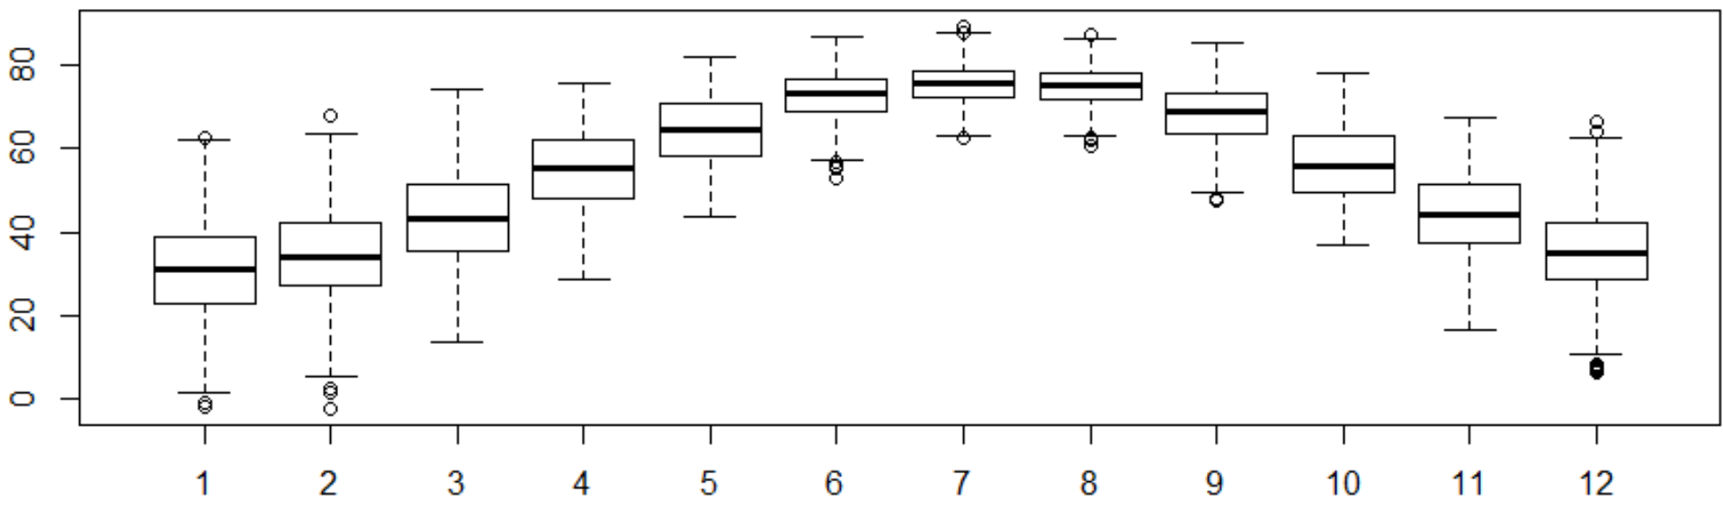
solution
# 5. Look at the distribution of temperatures by month. What kind of pattern do
# you see?
boxplot(Temp ~ Month, data = weather)

Slide 63

MIDTERM PROJECT

Slide 64
MIDTERM PROJECT: HIGHLIGHTS
Work by yourself or with one other person
If working as a pair, the other person does not need to come from your exercise group (i.e., you can pick anyone else)
You will determine your individual/pair status in your homework.
Can’t switch/change individual/pair status after you declare this week
Purpose of midterm
Select data set, clean it, state your plan of action to deliver insights from your data that will turn into actions
Halfway checkpoint to prepare for the final project (the finished product)
Purpose of final
Tell the story that you’ve planned from the midterm!
What actions can your audience take as a results of your insights?
Submit your midterm as a .Rmd file via Canopy.

Slide 65
MIDTERM PROJECT: FAQs
Where are the data sets?
On the course website!
How many data sets will I select?
One data set! Use the “Click here” link instead of downloading directly from GitHub.
What is an insight?
Knowledge and wisdom gained from analyzing data (visualizations, summaries, tables, quick counts)
Never underestimate the power of a simple statistic or visualization. These are almost always easier to take action on than machine learning models.
Am I required to do any machine learning?
NO! Machine learning is OPTIONAL. You will complete all EDA first before even thinking about machine learning.
Should I include this final project in my portfolio of work after this semester?
YES!

Slide 66

FOR NEXT WEEK

Slide 67
Reading and homework
Check the course website (Week 2 page) for readings to complete before next week’s class.
“Because reading is what? FUNDAMENTAL.” -- RuPaul
Homework #2 is FAST!
Submit homework via Canopy.
Read the assignment for details.
You should start your midterm project ASAP. There is a lot to complete.
Expect to spend at least 10 hours cleaning, preparing, and storyboarding for your midterm.

Slide 68

coding exercises

Slide 69
group coding exercises
To get you comfortable with the procedures an analyst takes to get to know their data, spend the next 60 minutes working through the tasks in the “Coding exercises” PDF in the class download folder.

